Slide 1
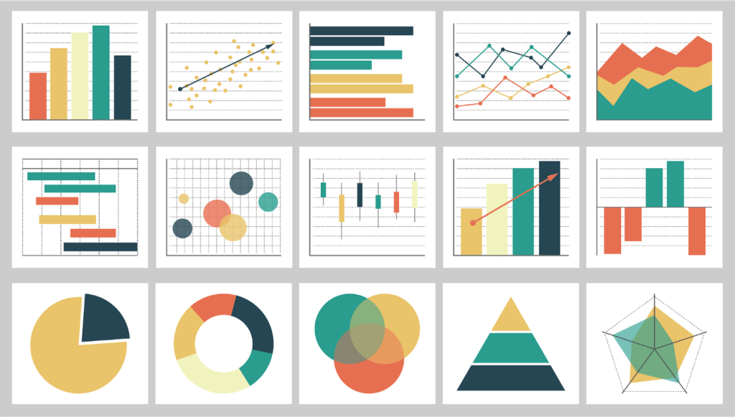
The Object-Oriented (OO) Paradigm
The Concept: Moving beyond plt.plot() (Functional) to the fig, ax structure (Object-Oriented).
The "Canvas" Analogy:
The Figure is the physical canvas or window.
The Axes are the individual charts or "subplots" sitting on that canvas.
Why it matters: This approach provides granular control over every pixel, label, and tick mark, which is essential for multi-panel professional reports.

Slide 2
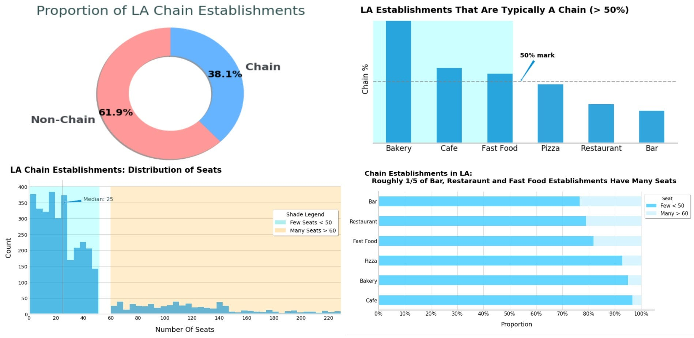
Statistical Storytelling
Beyond Bar Charts: Simple averages often hide the truth.
Box-plots: Visualizing the "Five-Number Summary" (Min, Q1, Median, Q3, Max) and detecting outliers.
Violin-plots: Combining box-plots with a density curve to show the "shape" and "frequency" of data.
Joint-plots: Seeing the relationship between two variables and their individual distributions at the same time.

Slide 3
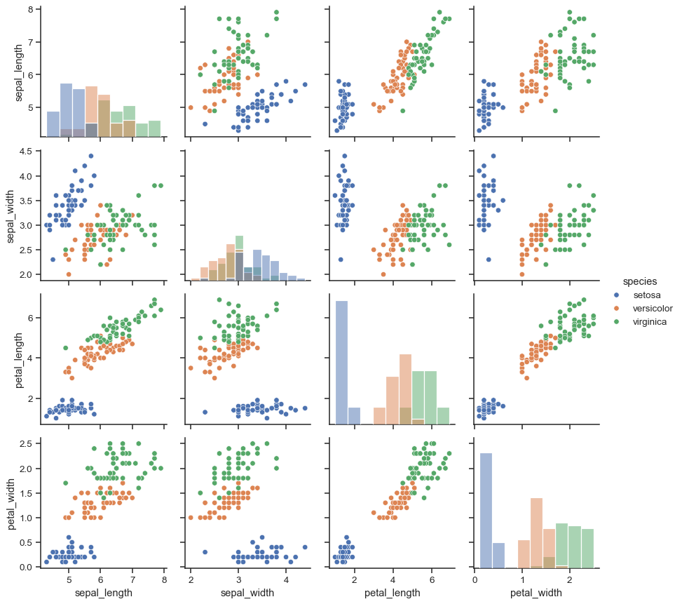
FacetGrids (Small Multiples)
The Dimensionality Problem: How do you show a trend across 10 different cities or 5 different years in one view?
FacetGrids: Breaking a single dataset into a grid of multiple small charts based on a category.
Efficiency: It allows for immediate visual comparison across subsets of data without cluttering a single chart.

Slide 4
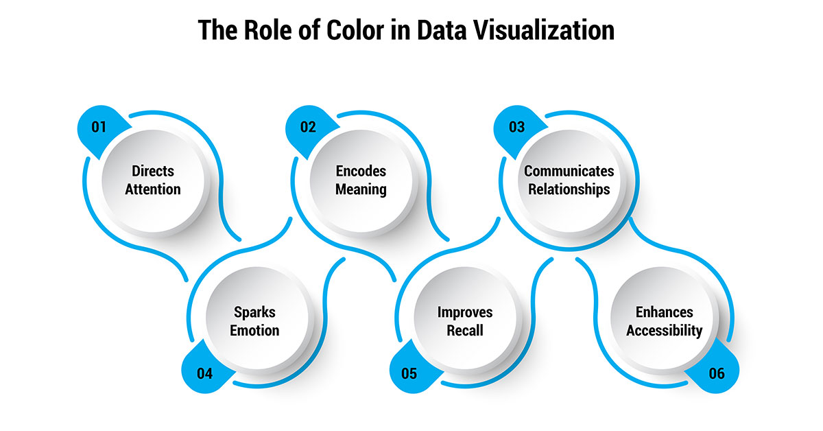
Color Theory & Ethics
The Narrative of Color: Colors should highlight data, not distract from it.
Professional Palettes: Moving away from "Default" colors to "Sequential" (for levels), "Diverging" (for positive/negative), and "Qualitative" (for categories).
Accessibility: Ensuring charts are Colorblind-friendly (using palettes like 'viridis' or 'colorblind') to ensure information is accessible to all stakeholders.

